Slide 1
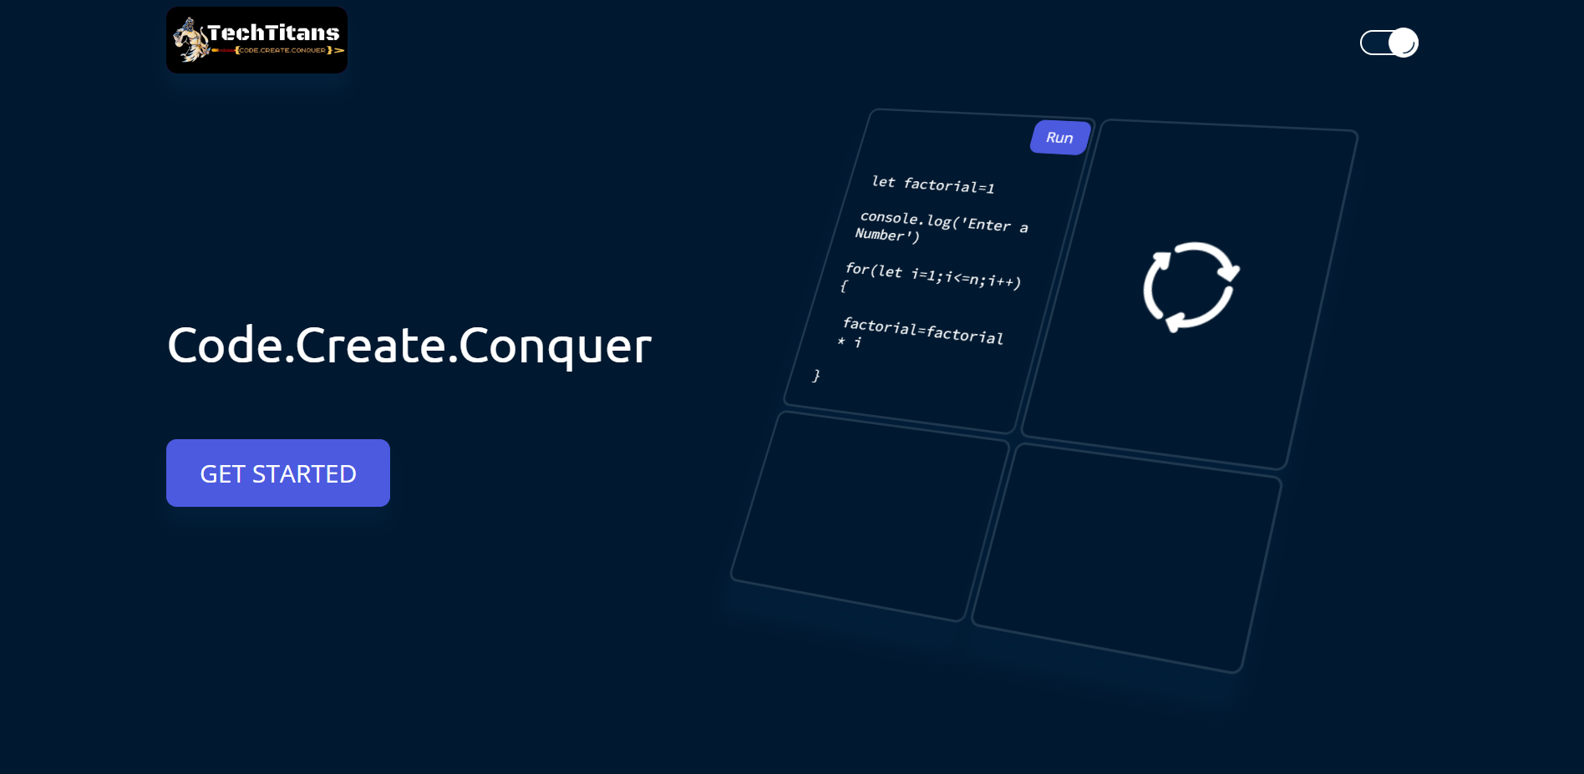
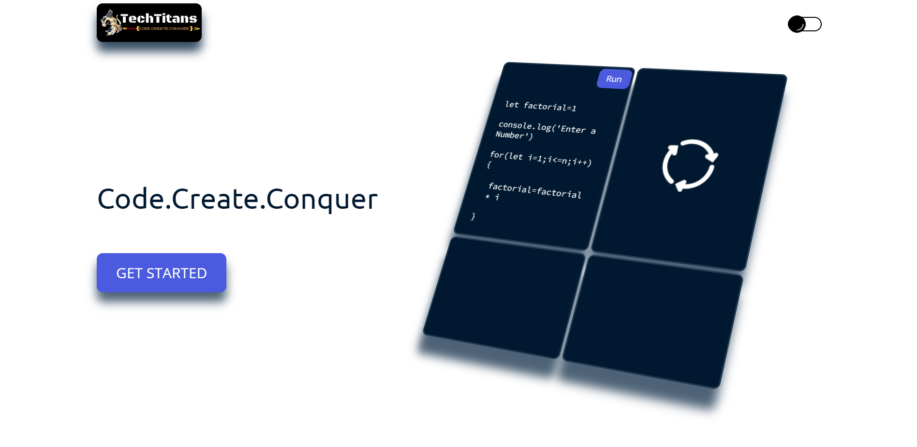
TechTitans
code.create.conquer
Mentor: Dr. Shraddha Dudhani

Slide 2
Vision
Empowering Growth
Fostering Collaboration
Driving Innovation
Building a Supportive community
Making a Positive Impact

Slide 3
What will we do in TechTitans?
Coding Challenges
Workshops and Training
Mentorship Programs
Guest Lectures and Tech Talks
Networking Opportunities

Slide 4
Tech Stack
MongoDb
ExpressJs
ReactJs
NodeJs

Slide 5
Modules
Registration Module
User Profile Module
Event
Suggestions
Coding Questions
Interview Questions
Blogs

Slide 6


Slide 7

Supporting information
02
82%
Users are constantly searching for a solution
Explain why you’re focusing on a particular part of the problem or a particular subset of users.

Slide 8
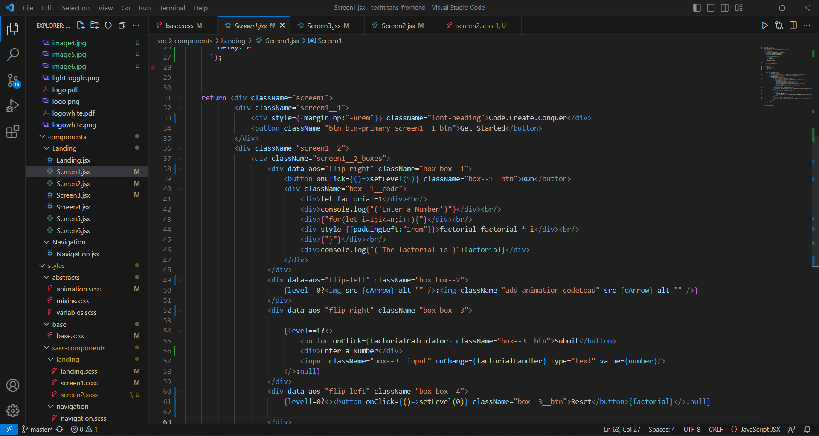

Supporting information
03
Julia
Team Manager
Reference your personas, if you have them.
Describe the content of Julia’s job and the problem she and her team are currently facing.

Slide 9
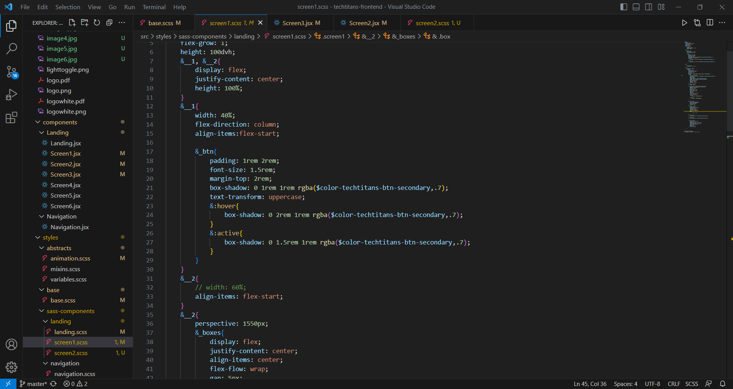
Use cases / user stories
Use cases, user stories, notes to set up the wireframes. Such as…
“As an Administrator, I would like to restrict permissions based on role.”
“As a Moderator, I would like to flag and approve comments.”
Executives indicated that being able to see a summary of each segment of data was their #1 priority.
Note: secondary admin workflow not planned for this release.

Slide 10
Thank You

